Slide 1
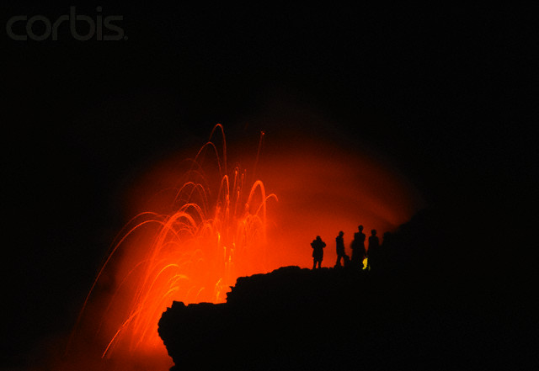
Volcanic Features
Vent collapse and/or erosion
Pyroclastic eruptions
Lava flows and related features
Notes:
By far the most tourism-promoting eruptions are spectacular lava fountains. The higher the lava shoots, the greater the likelihood it will solidify in the air and land as pyroclastic particles.

Slide 2
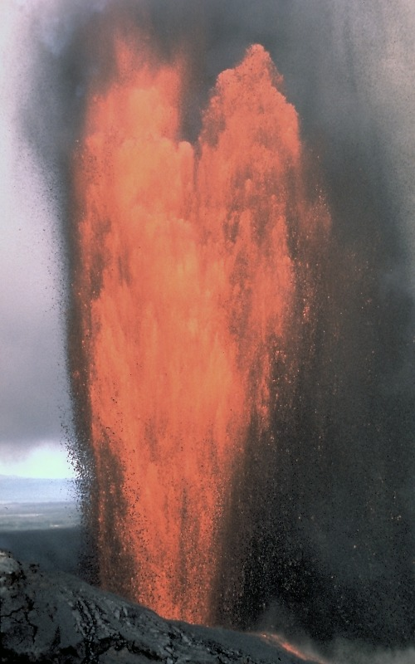
2/4/85
Pu’u O’o at full throttle!
Cinders, pumice, Pele’s hair, Pele’s tears
Cinder-and-spatter cone
Lava flow
Notes:
This 1985 photo of Pu`u `O`o at full throttle shows black clouds of cooled lava fragments containing Pele's hair and Pele's tears (thin filaments and droplets, respectively, of volcanic glass), cinders, and pumice. Most of the cooled airborne material falls to earth close to the vent and contributes to the growing cinder-and-spatter cone.

Slide 3
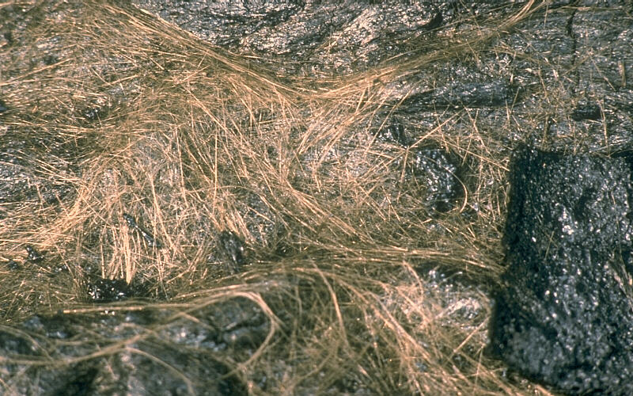
Pele’s hair
Notes:
Pele's hair, the lightest material, can be carried downwind for many miles. The sometimes 2m-long strands are formed by the stretching or blowing-out of molten basaltic glass from lava, usually from lava fountains, lava cascades, and vigorous lava flows.

Slide 4
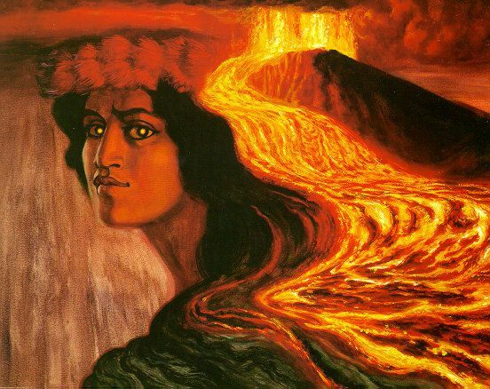
The Goddess Pele
Notes:
Pele, is the Hawaiian goddess of volcanoes. According to legend, Pele's father sent her away from Tahiti because she had a hot temper. It seems she was always fighting with her older sister - the Goddess of the Sea. Pele left Tahiti in a canoe and went to Hawaii where she made many fiery volcanoes. However, every time she made a volcano, her sister (who had followed her) flooded the fire and put it out. (Sounds a bit like hot spot shield formation doesn't it?) Finally, they had a very big fight and Pele was torn apart by her sister. Then, Pele's spirit was free and she became a goddess. It is said that Pele's spirit lives in the Kilauea volcano as evidenced by her hair …

Slide 5
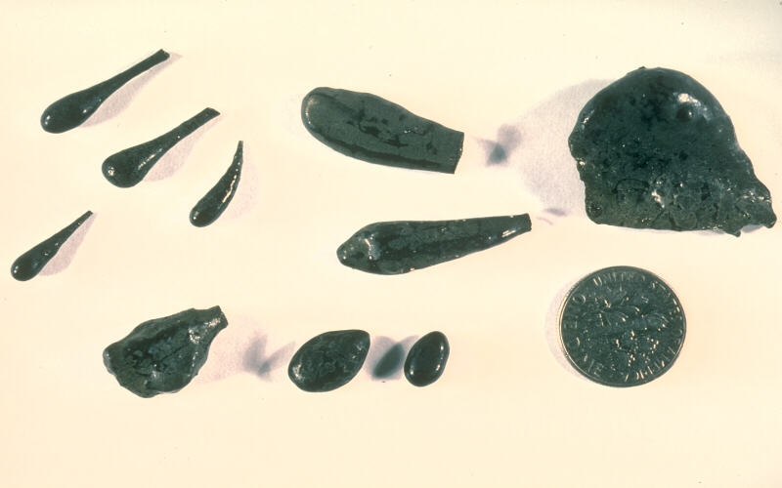
Pele’s tears
Notes:
.. and tears which are scattered nearby. The spherical to tear drop-shaped particles of volcanic glass are often found on one end of a strand of Pele's hair and are usually formed during vigorous lava fountaining activity.

Slide 6
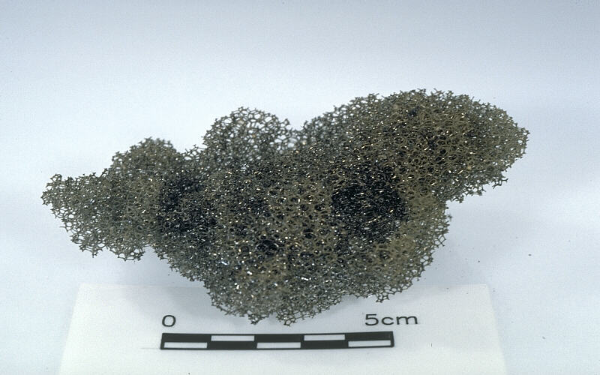
Reticulite or “thread-lace scoria”
Notes:
Apparently Pele didn’t do housework otherwise this probably would have been named “Pele’s Sponge”! Instead it is called reticulite or thread-lace scoria, which is basaltic pumice in which nearly all cell walls of gas bubbles have burst, leaving a honeycomb-like structure. Like Pele’s Hair and Pele’s Tears, reticulite forms during energetic fountaining.

Slide 7
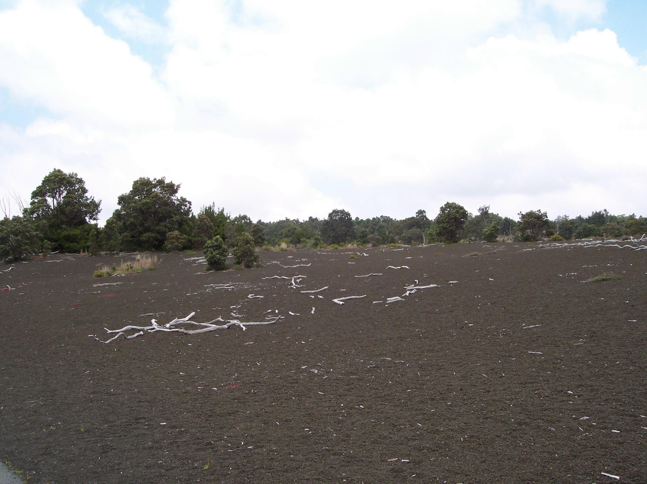
Devastation Area
Notes:
Much of the basaltic lava that solidifies in the air from exceptionally high lava fountains lands as lapilli and cinders. During the 1959 eruption of Kilauea Iki a wide area up to 5km downwind was blanketed with the pea to walnut-sized tephra and is known as the Devastation Area because of the widespread destruction of vegetation.

Slide 8
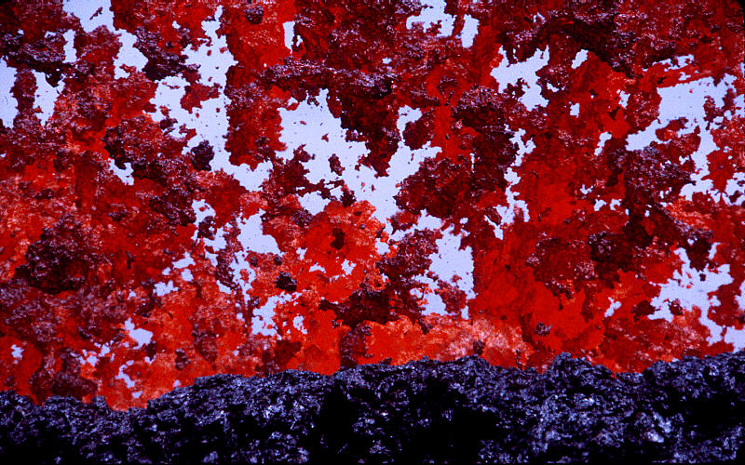
Spatter
Notes:
Less vigorous fountains may not cool the lava to full solidity and thus form the semi-solid lava clots known as spatter.

Slide 9
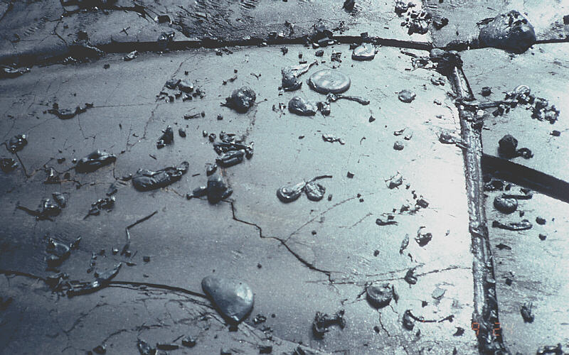
Solidified spatter
Notes:
This photo gives you a good idea of the consistency of spatter.

Slide 10
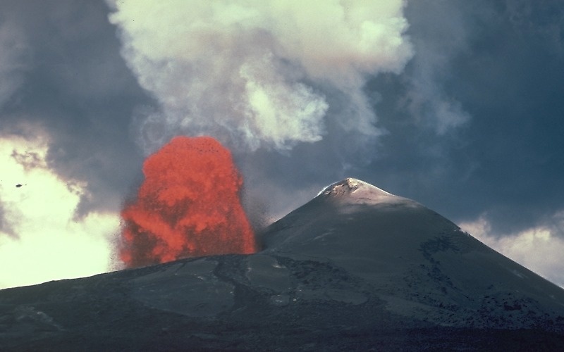
Asymmetric Pu’u O’o cone. 6/2/86
Notes:
Cinders, lapilli and spatter formed a decidedly asymmetric cone at Pu’u O’o because the prevailing trade winds blow from the northeast, so that most of the fallout from the high fountains lands on the downwind (right) side of the conduit.

Slide 11
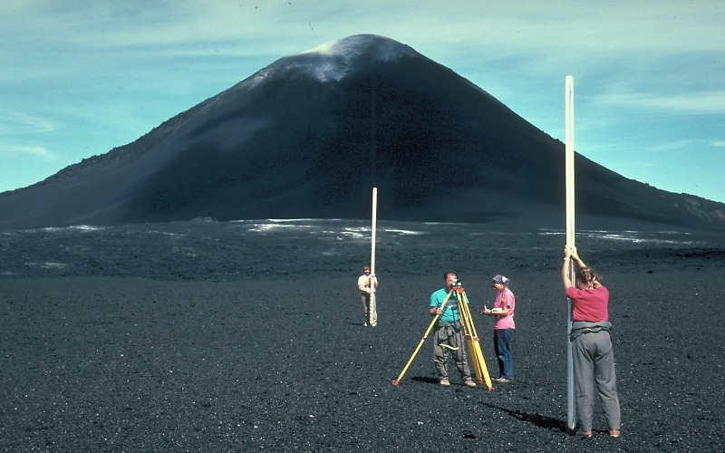
Final 255m Pu’u O’o cone.
Notes:
The Pu`u `O`o cone grew with each eruptive episode, eventually reaching a height of 255 m above the pre-eruption surface.

Slide 12
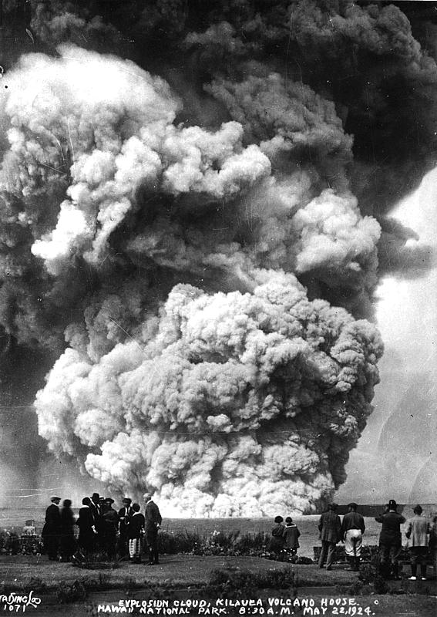
Phreatic explosion of Halema’ uma’ u, Kilauea, 1924
Notes:
Although great volumes of pyroclastic particles may be ejected during phreatic (steam) explosions on shield volcanoes, the relatively infrequent events do not create cinder cones because the explosively expanding steam spreads the pyroclastics out over a much larger area compared to that covered by cinders and spatter falling from lava fountains. The 1924 phreatic explosion of Halema’uma’u happened as groundwater flowed down faults formed after a major magma draw back episode. As the water encountered the searing hot rock at depth, hundreds of stream explosions took place that more than doubled the diameter of Halema’uma’u crater and deepened it to a gaping 410 meters. Completely phreatic explosions like this erupt no magma,

Slide 13
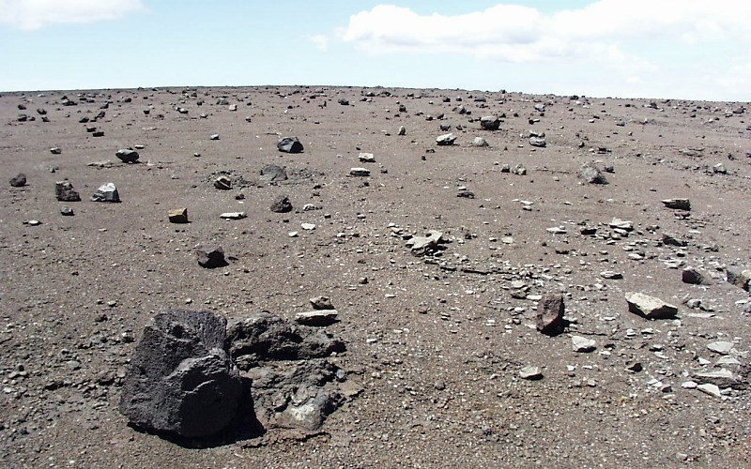
Volcanic Blocks from Halema’uma’u Explosions of 1924
Notes:
… but may spread explosion-fragmented rock debris over vast areas. Notice the angularity of these so called volcanic blocks, which are broken pieces of volcanic rocks that existed prior to the explosion. Blocks weighing several tons were thrown as far as 1,000 m from Halema`uma`u.

Slide 14
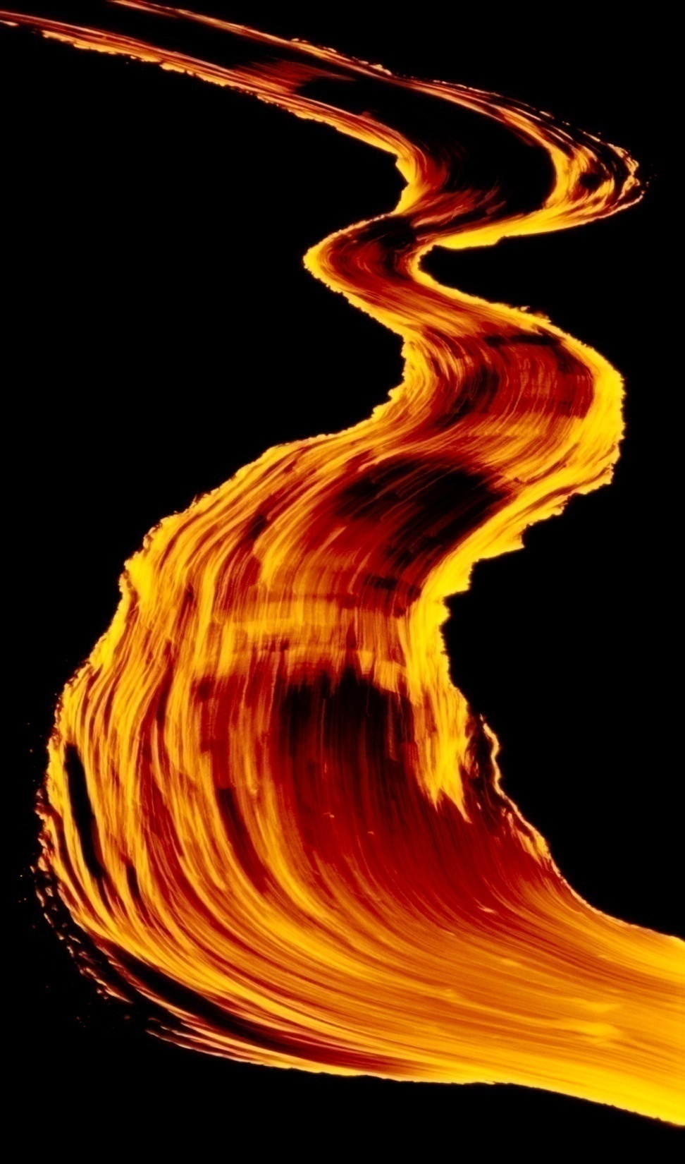
Volcanic Features
Vent collapse and/or erosion
Pyroclastic eruptions
Lava flows and related features
Vents
Lava tubes
Lava types (chaos theory)
Notes:
The final set of volcanic features we will examine are all associated with lava. Here we will first look at some of the different types of vents where lava first begins to pour out onto the earth’s surface. We’ll see that they have a major influence on how the lava behaves after is flows away from the vent. Then we shall examine the origin, processes and features associated with lava tubes – the dominant mechanism by which lava is transported over great distances. Finally we’ll take a close look at the behavior of aa and pahoehoe – two distinctly different types of basaltic lava and see how chaos theory provides a paradigm by which to see order within these often seemingly chaotic phenomenon.

Slide 15
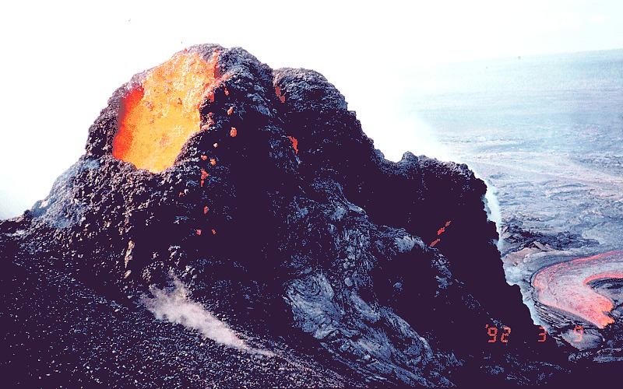
Spatter and cinder cone on Pu’u O’o flank
Notes:
Lava behavior depends on the volume, temperature and composition of magma erupted, which in turn determines the character of the vent. For example: A small volume of relatively cool, low-gas magma will erupt to typically form a spatter cone. In this end-member example, no lava is produced.

Slide 16
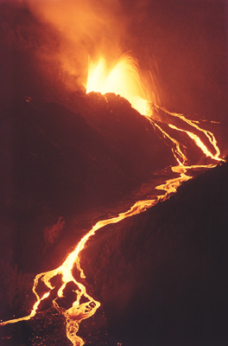
Kilauea lava flow
Notes:
Lava production increases when greater volumes of magma are erupted and the magma is erupted at higher temperatures. Although gas content decreases the viscosity of the magma and thereby makes it easier to flow away from the vent as lava, …

Slide 17
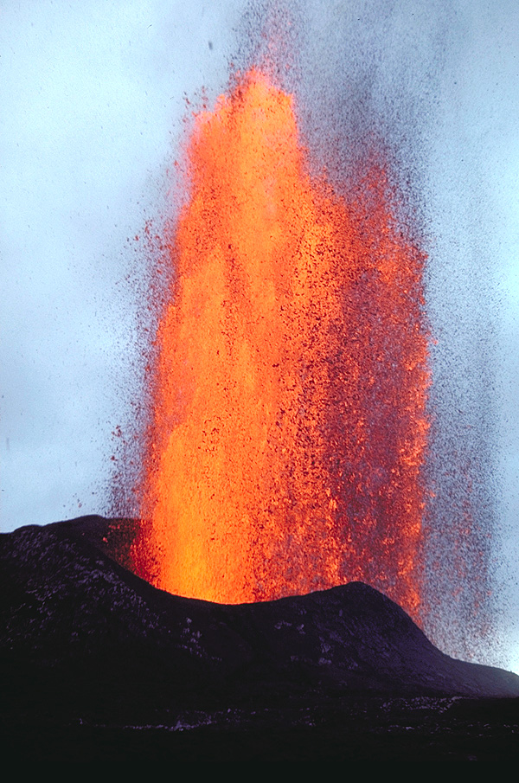
Notes:
… very high gas content results in higher fountaining, which causes more lava to solidify in the air to form pyroclastics instead of lava. Even if pyroclastics do not form, fountaining can still influence lava formation because the associated agitation can drive-off gases which would otherwise lower lava viscosity. Fountain-induced agitation can further increase lava viscosity by increasing internal shear-stress – a process I admit I do not fully understand, but apparently one important in the conversion of fluid pahoehoe lava to blocky aa lava.

Slide 18
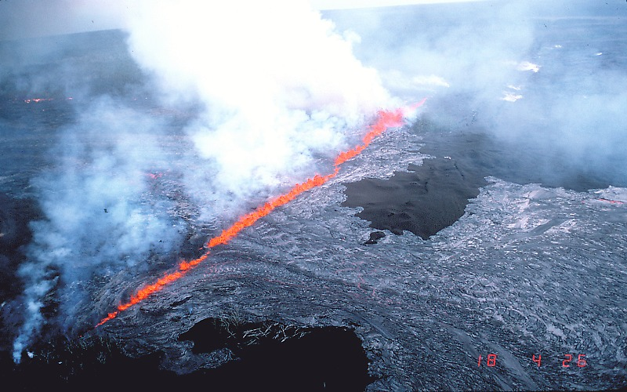
Newly opened fissures uprift of Pu’u O’o 7/18/86
Notes:
Good conditions for producing copious amounts of lava are fissure eruptions along the rifts, because the eruption is spread out,

Slide 19
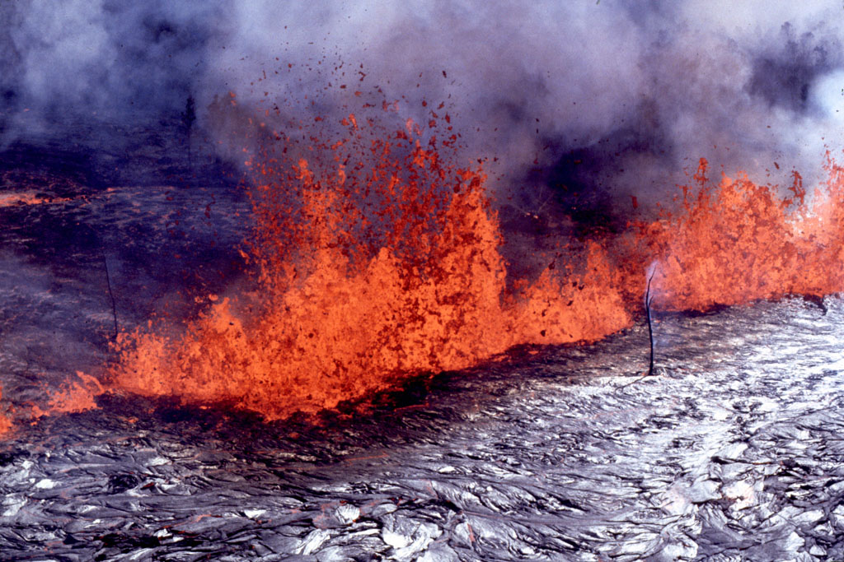
Notes:
… so gas expansion does not cause as vigorous fountaining as would be the case had all this magma exited via a single vent. Not the charred trees for scale.

Slide 20
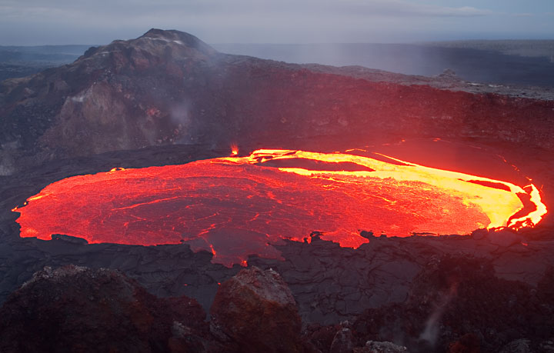
Kilauea lava lake
Notes:
Perhaps the ideal source for lava is a lava lake. Air-induced cooling and agitation are at a minimum here so huge amounts of lava can derive from lava lakes when they overfill. The overflow of a lava lake often initiates the formation of lava tubes which can transport the lava great distances from the lake.

Slide 21
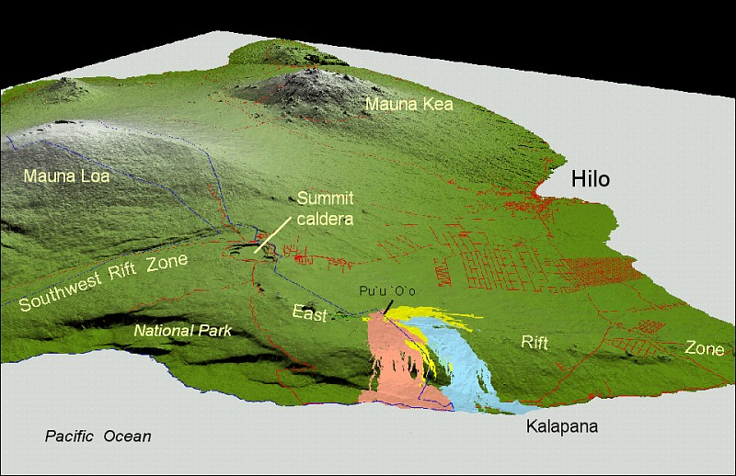
Pu`u `Ō `ō
Kupaianaha
Notes:
Such was the case when the activity at Pu’u O’o shifted to Kupaianaha, …

Slide 22
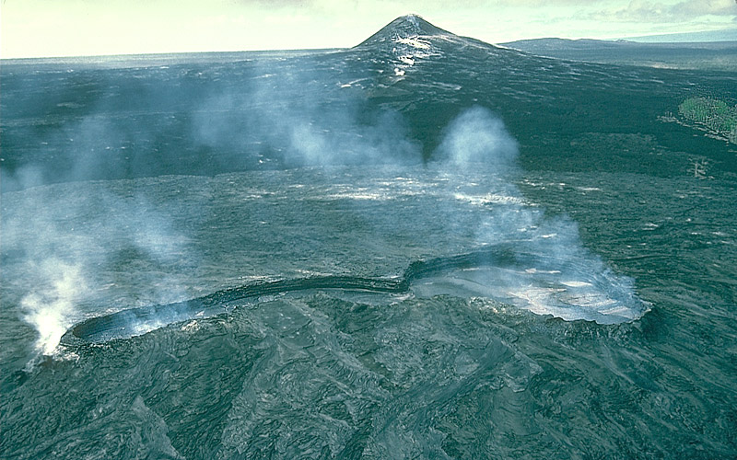
Lava pond and sheil atop Kupaianaha vent.
Notes:
… where within weeks, a lava pond formed atop the vent and a low shield grew as lava repeatedly spilled over the rim of the pond.

Slide 23
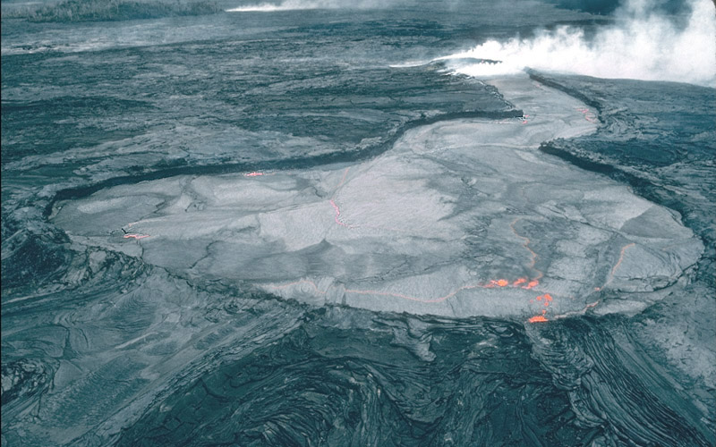
Lava channel becomes lava tube, which soon reached sea.
Notes:
After weeks of continuous eruption, the main lava channel leading from the Kupaianaha pond gradually roofed over to form a tube.

Slide 24
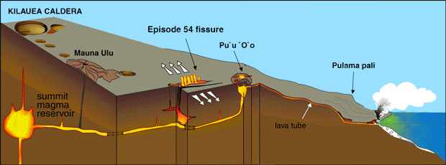
Notes:
Lava flowing through the tube system soon reached the sea -

Slide 25
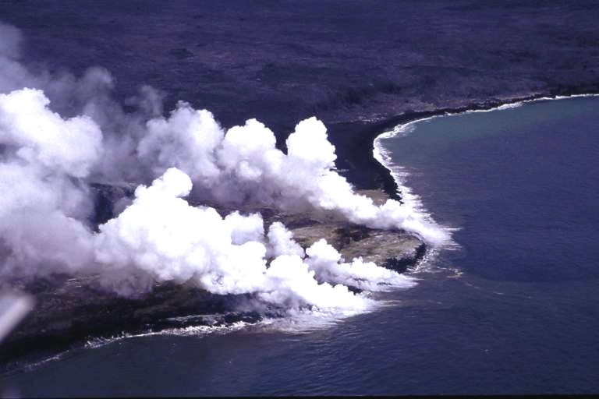
Notes:
… adding new land to Hawai`i, …

Slide 26
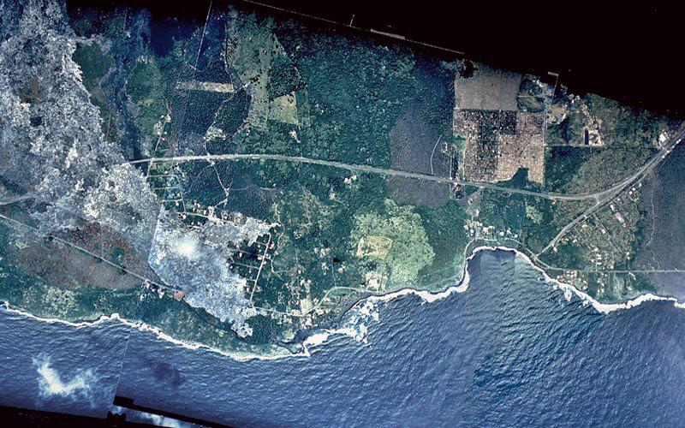
Kalapana before
Notes:
… but also made its way into the Kalapana area, …

Slide 27
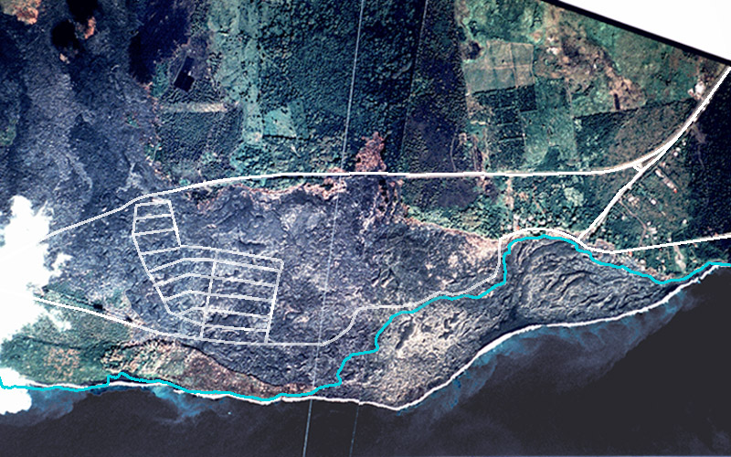
Kalapana after
Notes:
… covering roads and burning several homes …

Slide 28
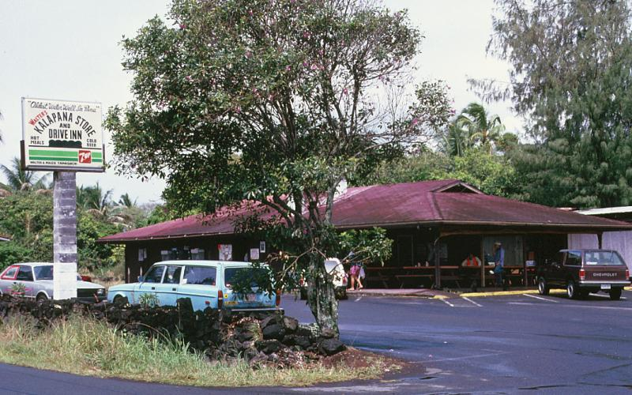
Kalapana store before
Notes:
… and …

Slide 29
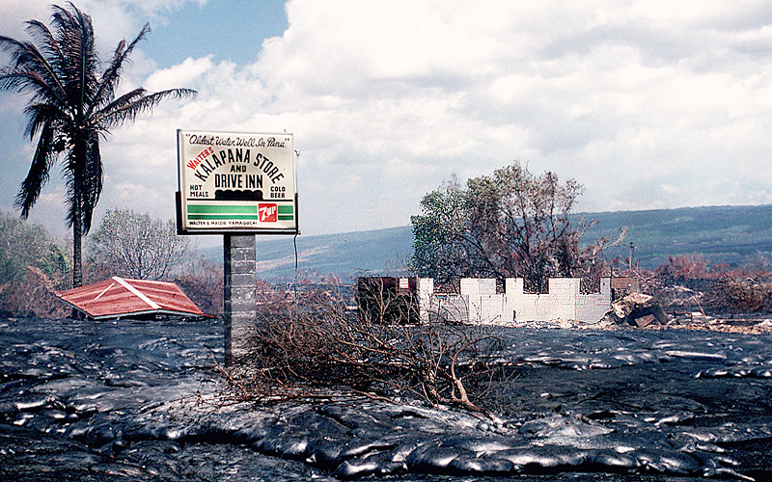
Kalapana store after
Notes:
… businesses.

Slide 30
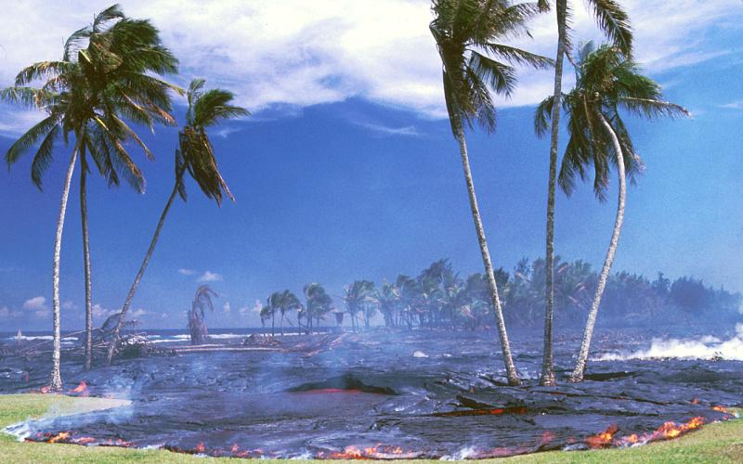
Notes:
Lava tubes can feed lava into seemingly safe areas miles away from a vent and transform paradise into sterile rock in a matter of hours. Lava that pours out the end of a lava tube …

Slide 31
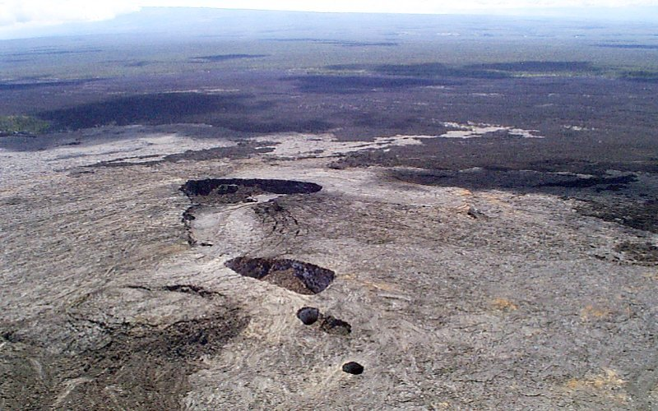
Kupainaha shield and collapse pits, 1986
summit crater
collapse pits
Notes:
… is generally replaced by fresh lava at the vent, but should that supply be reduced or cut off, as happened when activity shifted from Kupainaha back to Pu’u O’o, much of the existing lava in the tube will drain out – leaving the tube’s roof unsupported. Large collapse pits may form along the tube near the vent where high heat flow prevents a thick crust from forming over the tube.

Slide 32
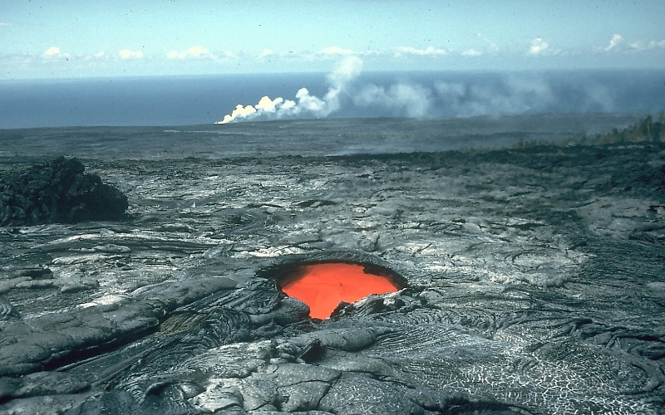
Lava tube skylight and distant sea entry
Notes:
A smaller version of a collapse pit, a simple opening in the roof of a lava tube, is called a skylight. If the tube is active, a stream of glowing lava can be seen moving below, which combined with steam from the distant water entry in this photo, gives you a good idea of how far lava can flow through lava tubes. Without lava tubes, far more lava would solidify near the vent and the volcano would have steeper slopes. Skylights usually form when part of the roof collapses into the tube, …

Slide 33
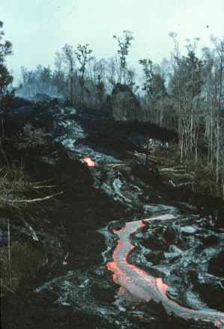
Notes:
… but they also occur where a roof failed to form over the lava channel. Here we see a lava flow beginning to crust over to form a lava tube.

Slide 34
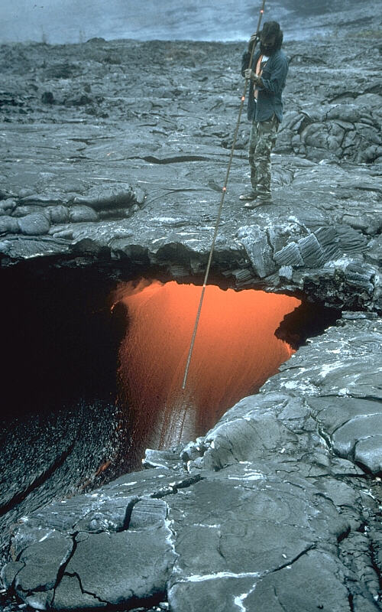
Notes:
Scientists (or expendable volunteers!) take advantage of skylights to measure lava characteristics such as the height of lava flowing in the tube (shown here) ….

Slide 35
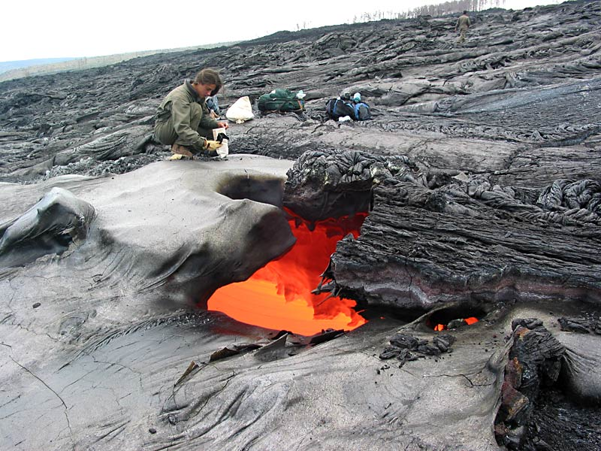
Notes:
… or by throwing a tethered hammer into the lava, to collect samples of the lava itself. If you peer into the skylight here …

Slide 36
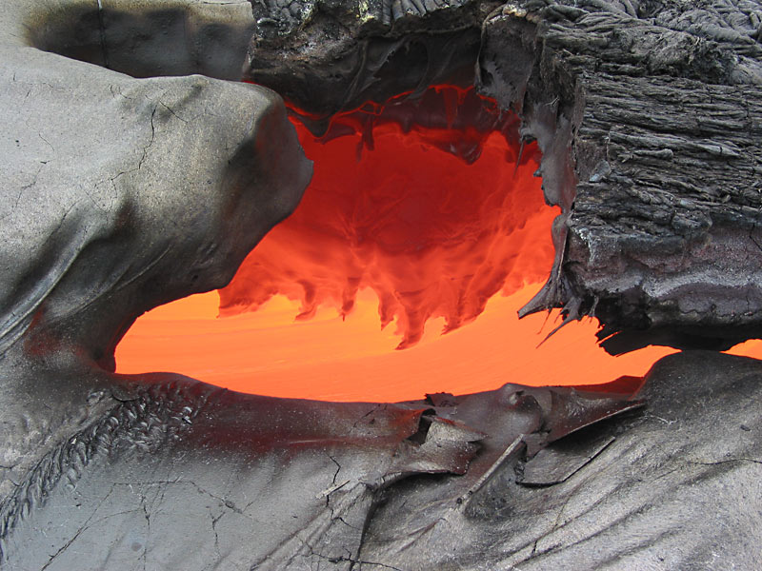
Notes:
… you can see the hot, incandescent lava flowing below and lava stalactites hanging from the somewhat cooler roof above. The smooth lava surface at the bottom of the photo shows that lava poured out of this skylight during a time of higher lava levels. Turbulence and/or effervescent gas can also throw spatter out of skylights, …

Slide 37
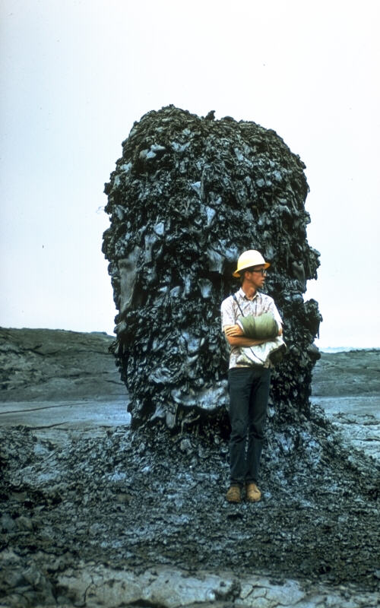
Hornito
Notes:
… which may accumulate around the opening to form hornitos. Typically, hornitos are steep sided and form conspicuous pinnacles or stacks. Unlike spatter cones at a vent, hornitos are smaller and "rootless" because they are fed by lava from the underlying flow instead of from a deeper magma conduit.

Slide 38
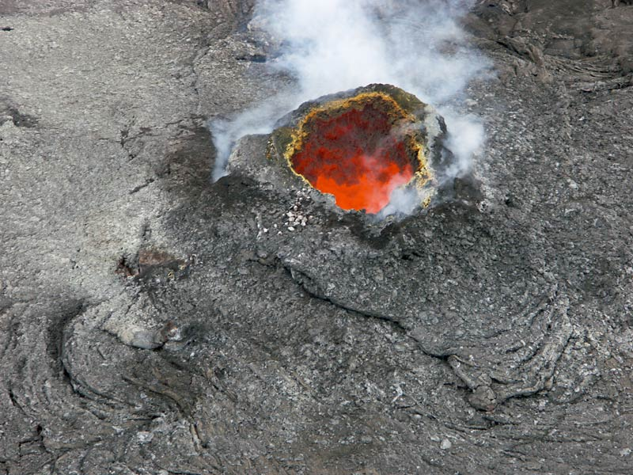
Notes:
Skylights also funnel gas escaping from the lava in the tub, …

Slide 39
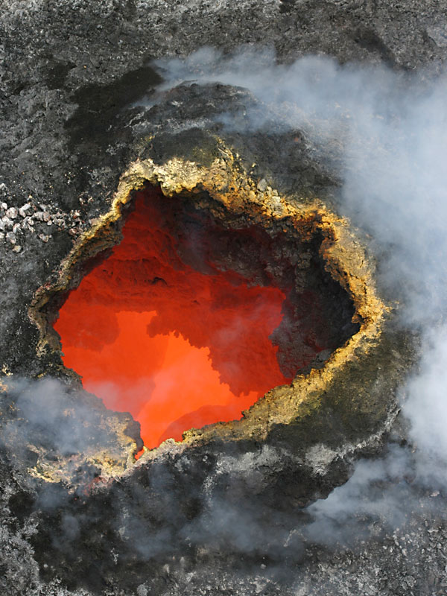
Notes:
… which deposit minerals such as sulfur on to the surrounding spatter.

Slide 40
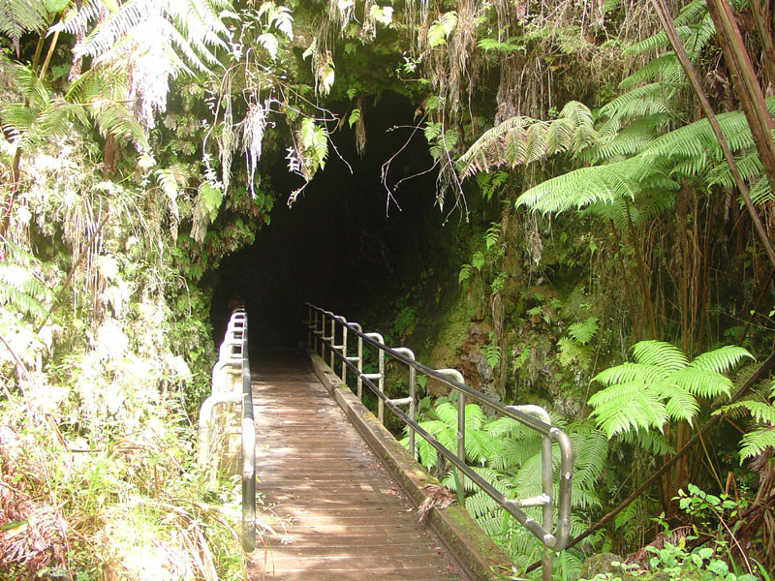
Thurston Lava Tube
Notes:
Thurston Lava Tube is an easily accessed drained lava tube just a few hundred meters east of Kilauea Ike crater.

Slide 41
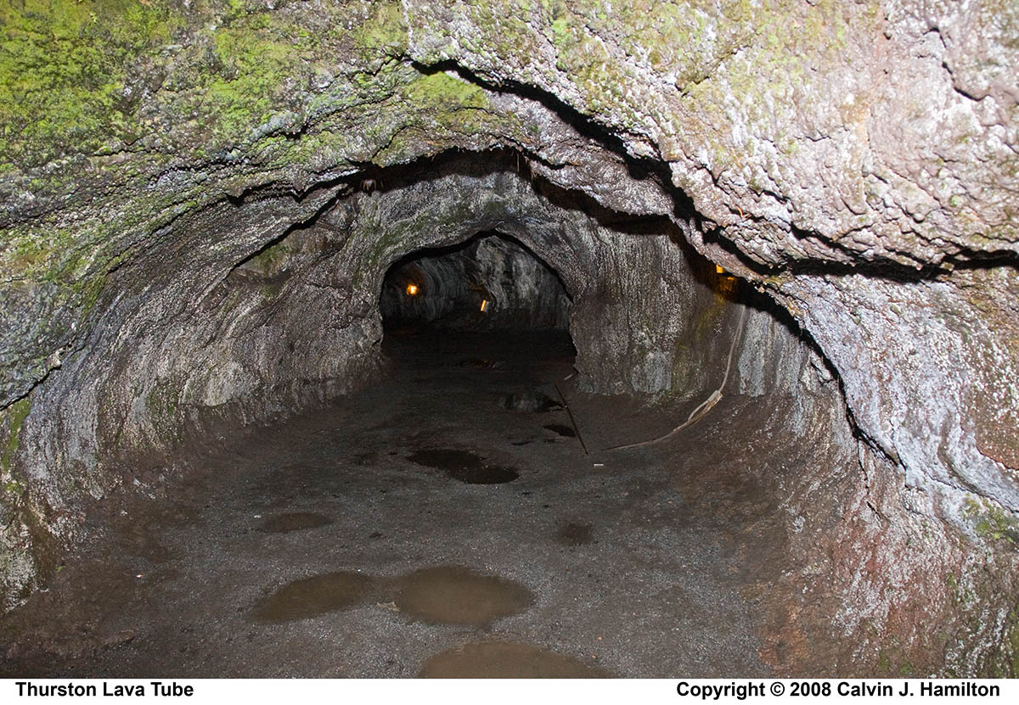
Flat floor
Notes:
As a fairly typical drained lava tube it exhibits generally flat floors atop the solidified lava flow, …

Slide 42
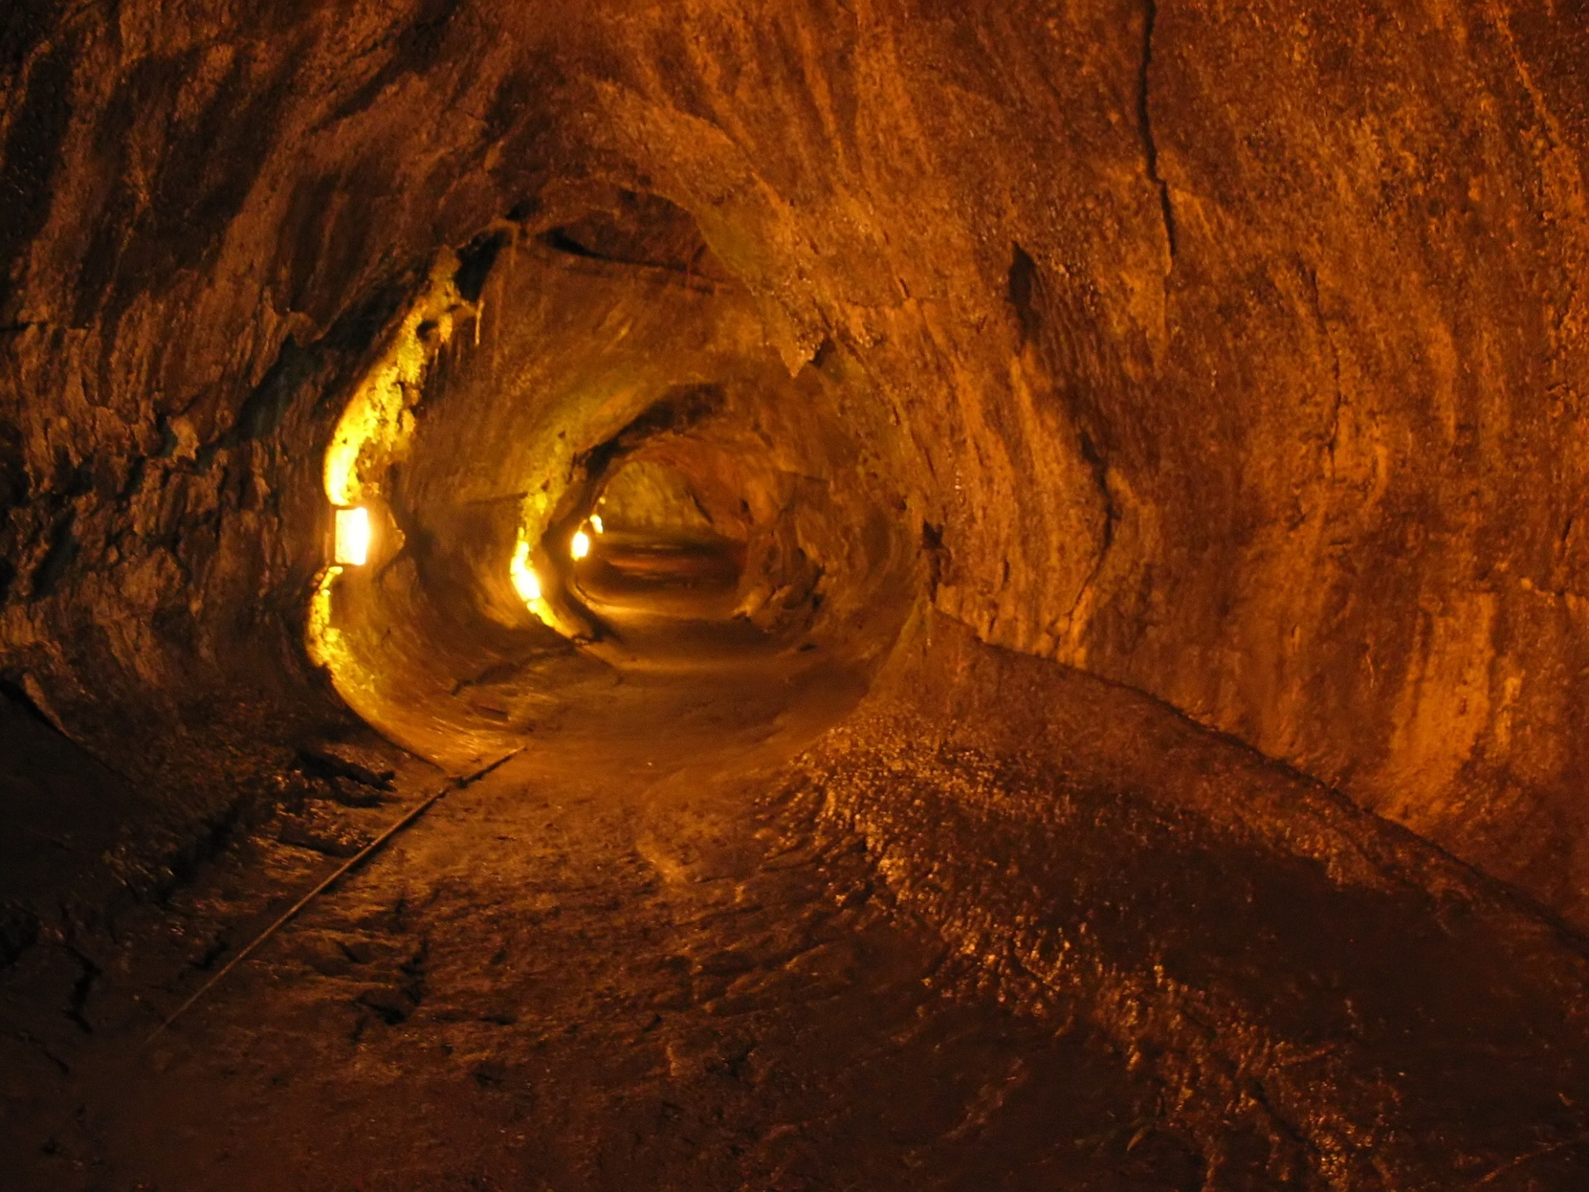
High lava marks
Notes:
… "high-lava" marks on its walls, …

Slide 43
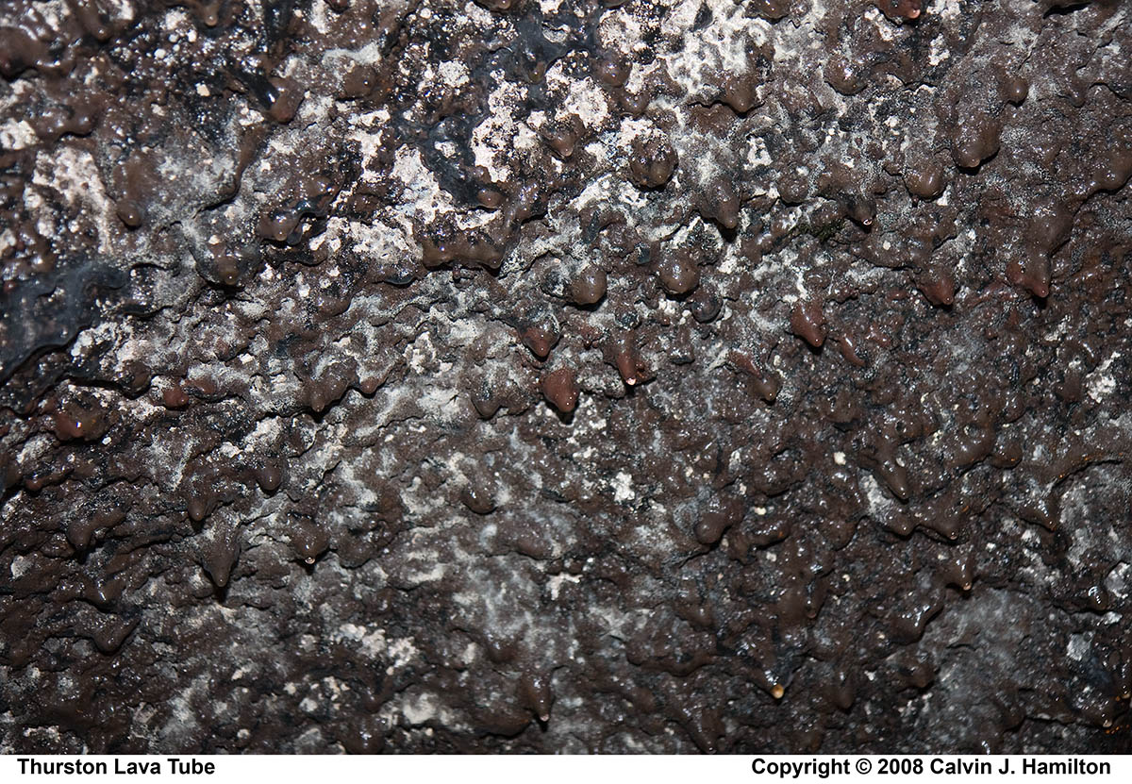
Notes:
and lava stalactites that hang from the roof. Apparently all the big ones were stolen after the cave’s discovery in the 1930’s.

Slide 44
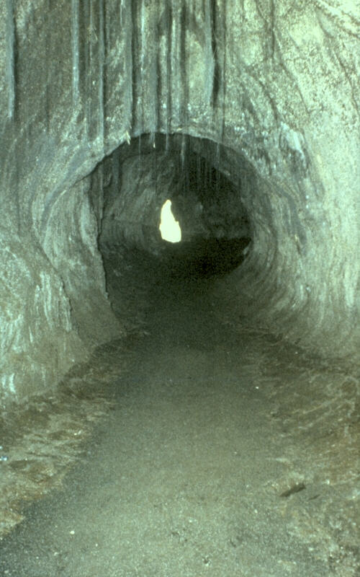
plant roots
Lava erosion
Notes:
Lava can also erode downward, deepening the tube and leaving empty space above the flowing lava.

Slide 45
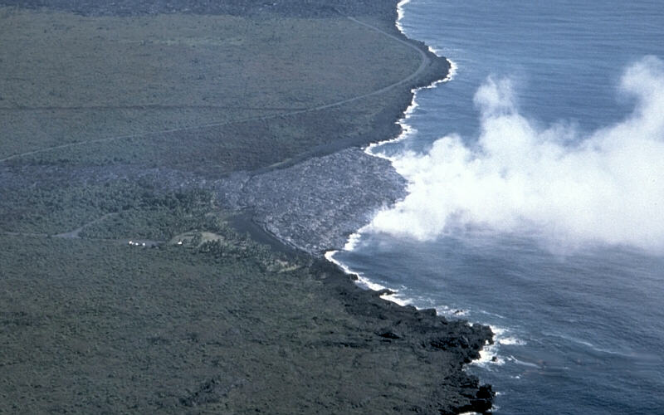
Lava delta growing seaward at Kamoamoa on Kilauea Volcano, Hawai`i, 1992
Notes:
Often the terminus of a lava tube is the ocean. Lava entering the sea often builds a wide fan-shaped area of new land called a lava delta. Such new land is usually built on sloping layers of loose lava fragments and flows. On steep submarine slopes, these layers of debris are unstable and often lead to the sudden collapse of lava deltas into the sea.

Slide 46
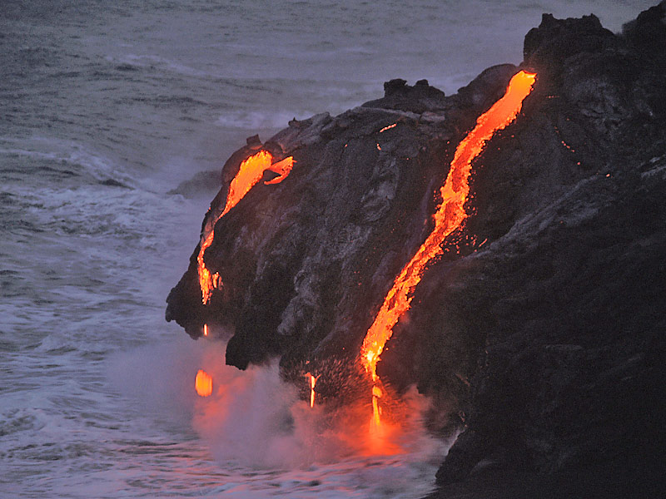
Notes:
But the primordial interaction between lava and ocean …

Slide 47
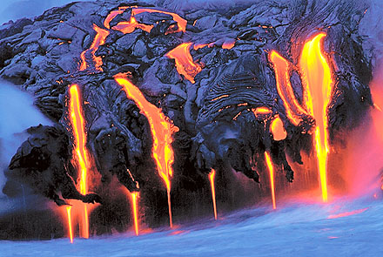
Notes:
… is a spellbinding attraction that lures throngs of park goers onto the unstable ground near the spectacle to get a better look.

Slide 48
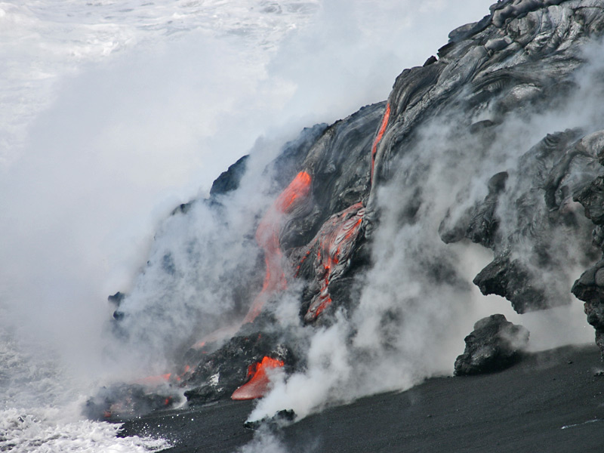
Black sand
Notes:
Waves that splash over the lava quickly cool the molten rock, creating steam and shattering the lava into glassy fragments which can become black sand beaches. Here the front of a lava delta advances across a newly formed black sand beach. Lava layered with loose sand like this is gravitational unstable where the ocean slopes off rapidly into deep water offshore.

Slide 49
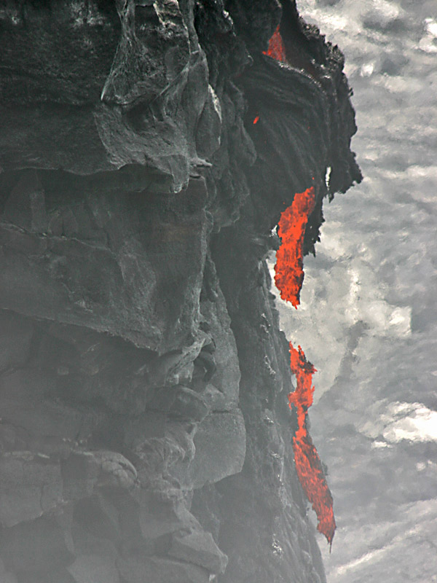
Notes:
Further instability arises by lava breaking apart and dropping into the water at the front of delta.

Slide 50
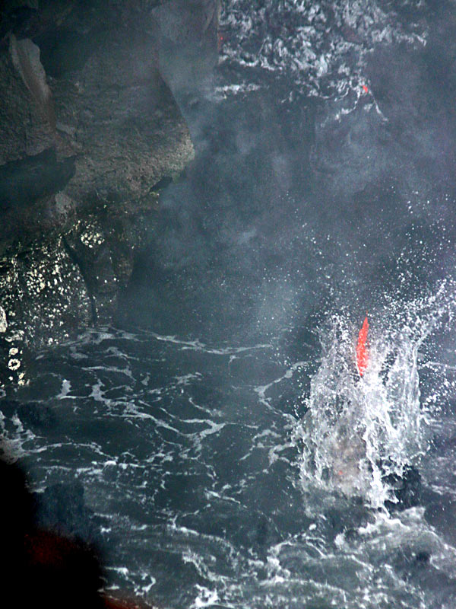
Notes:
The free-falling blobs of orphaned lava solidify to form layers of unconsolidated lava fragments …

Slide 51
Pillow lava
Pillow sack
Underwater flow
Notes:
… interbedded with pillow lava that poured out underwater. Pillows may drain to form “pillow sacks” – further adding to the instability of the lava delta.

Slide 52
Lava fragments tumble down submarine slope
Foreset beds
Notes:
Lava delta instability is also a function of the manner in which they grow out to sea. Notice how the loose lava fragments deposit on a steep slope as they tumble down the submarine slope. Sloping layers at the leading edge of a delta all called foreset beds.

Slide 53
Lava flows build lava delta across loose debris
Foreset beds
Notes:
Lava flows extend the lava delta across the loose, steeply sloping foreset beds …

Slide 54
Notes:
… for tens to hundreds of meters beyond the old shoreline. At the same time, the entire delta can slowly sink as the submarine debris pile shifts under the weight of the overlying lava flows. Zones of weakness may develop in the delta at any time during its growth …

Slide 55
Scarp
Lava bench
Notes:
… typically forming cracks along leading edge of delta which may develop into arcuate scarps when a portion of the lava delta subsides to form a lava bench. Scarps and cracks on a delta's leading edge identify areas that are likely to collapse.

Slide 56
lava delta collapses
Notes:
The leading edge of a growing lava delta collapses when the loose debris underneath slides down the submarine slope. The failure occurs because the loose fragmented debris underneath can no longer support the delta's growing mass or a deeper submarine landslide undercuts the delta. During collapses, the lava tube(s) either become cracked or completely severed.

Slide 57
Notes:
This usually results in the sudden explosive mixing of seawater and lava.

Slide 58
Notes:
People are strongly discouraged from standing on or near an active lava bench, especially near a lava tube that is delivering lava to the ocean.

Slide 59
former sea cliff
stable ground
Notes:
As a lava delta matures and its leading edge collapses and then advances seaward again, the former shoreline and sea cliff become increasingly difficult to identify. Note that the former sea cliff is buried by the delta and is the edge of stable ground.

Slide 60
Notes:
With the addition of new flows, the leading edge of the delta grows seaward again. In many cases, what appears to be a former sea cliff is actually the headwall scarp of an earlier collapse event that cut back into the middle of the delta; the sea cliff is still buried by the delta.

Slide 61
Notes:
I wonder if these people realize how precarious their position is!

Slide 62
Notes:
A similar bench collapsed in 1993, removing a block roughly the size of two football fields from the front of the delta. A visitor, standing on the bench at the time of the collapse, disappeared into the ocean.

Slide 63
Notes:
Slope failure also occurs on massive scales on the flanks of shield volcanoes. The Hilina Slump is a good example on the southeast slopes of Kilauea.

Slide 64
Oblique radar image of Hawai’i
Hilina Slump
Notes:
Vertical displacement on the Hilina Slump is up to 2000 meters and has produced pronounced scarps which show up nicely in this oblique radar image.

Slide 65
Notes:
As we will see shortly, the scarps associated with the Hilina Slump greatly affected the behavior of lava flows erupted from Pu’u O’o and Halema’uma’u.

